Slide 1

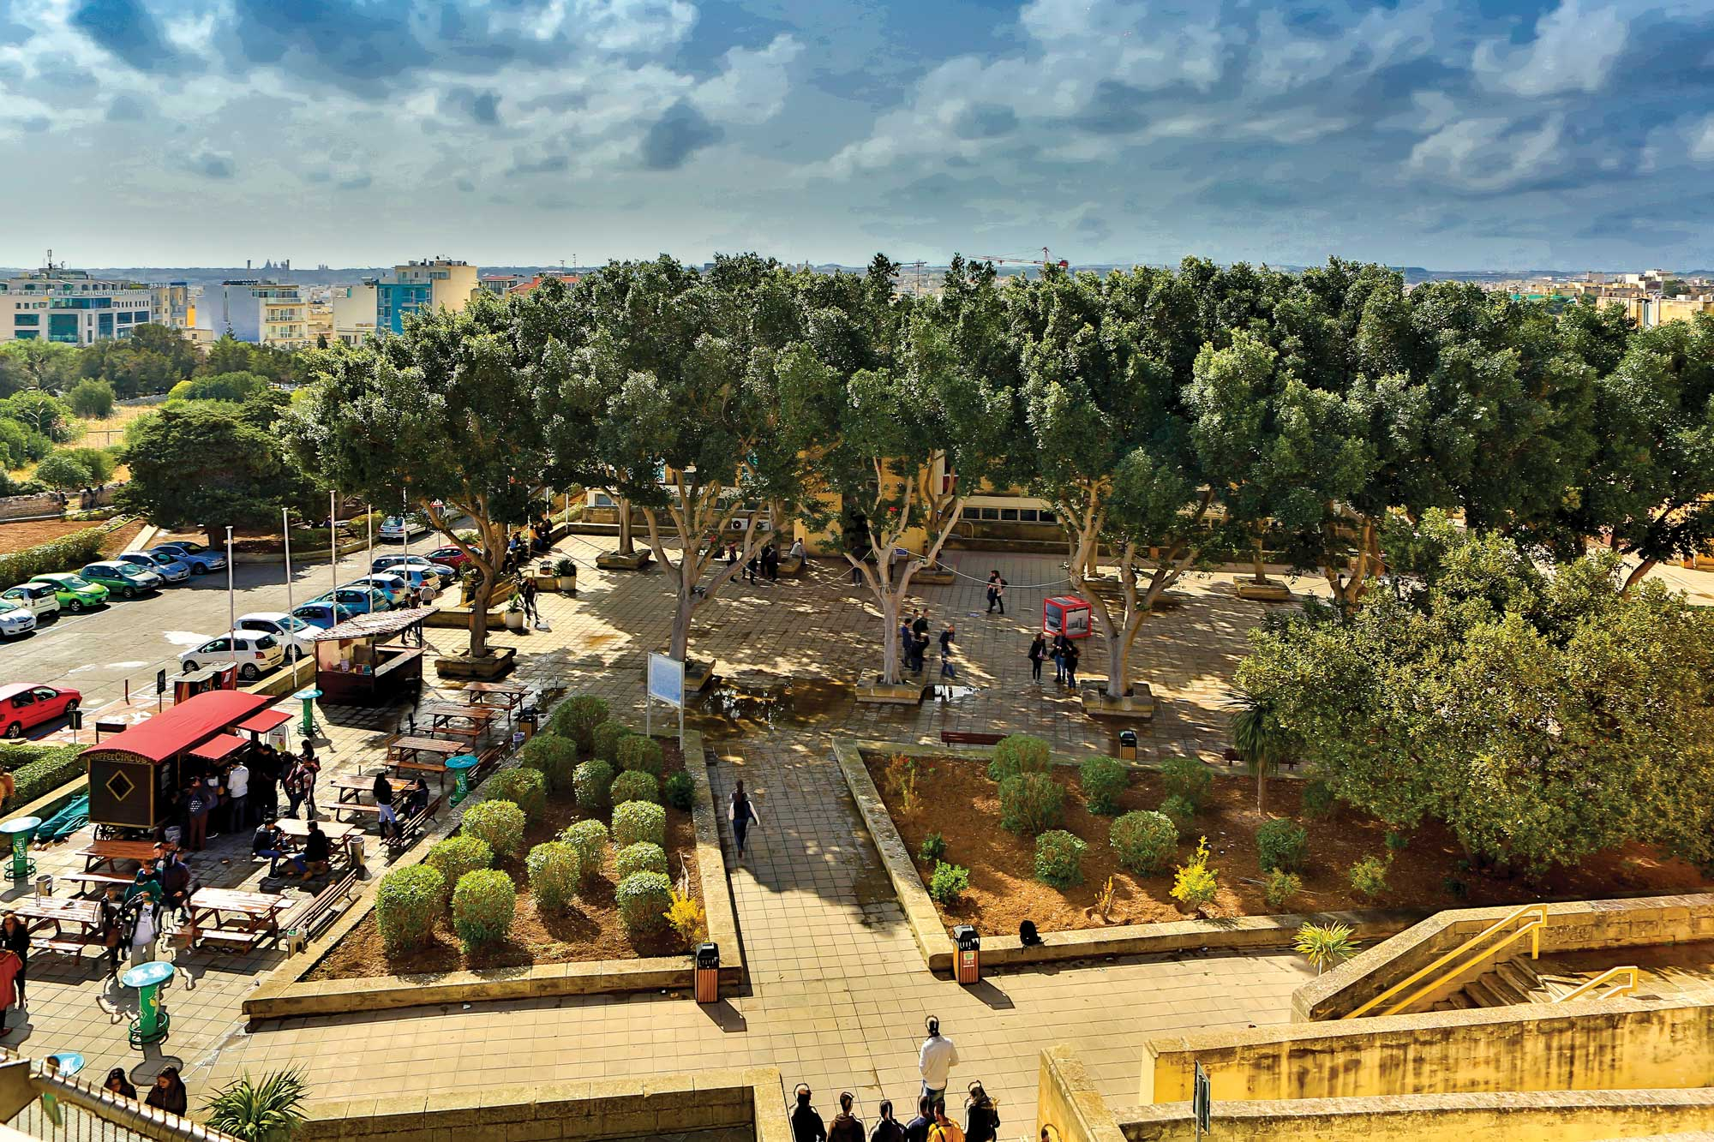



MALTAomics Summer School
Introduction to Transcriptomic Data Science
Panagiotis Alexiou
ERA Chair,
Bioinformatics for Genomics in Malta
(BioGeMT)

Slide 2




DNA
RNA
-omics
PROTEIN

Slide 3

DNA
RNA
-omics
STRUCTURE
FUNCTION
PHENOTYPE
PROTEIN
REGULATION

Slide 4
DNA
μ
RNA
-omics
STRUCTURE
FUNCTION
PHENOTYPE
disease
PROTEIN
REGULATION

Slide 5
DNA
STRUCTURE
RNA
FUNCTION
PHENOTYPE
REGULATION
-omics
STRUCTURE
FUNCTION
PHENOTYPE
PROTEIN
REGULATION

Slide 6
DNA
transcription
RNA
transcriptomics
Transcriptomics
PROTEIN

Slide 7

RNA
According to the central dogma, RNA has a passive, intermediary role as messenger, carrying information encoded in DNA to proteins, which are the main structural and enzymatic components of cells.
However, since this dogma was first conceptualized, the RNA world has exploded — partly as a consequence of advances in deep sequencing technology — to encompass a diverse universe of RNAs that are modified in hundreds of ways and transported to different locations in the cell and that have myriad functions beyond encoding.
In fact, mRNAs make up only a few percent of cellular RNA.
N Engl J Med 2018; 379:1278-1280 DOI: 10.1056/NEJMcibr1808725

Slide 8
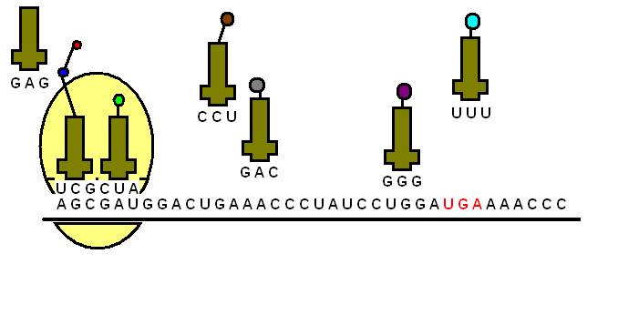
tRNA (~15%)
rRNA (~80%)
mRNA (~5%)
------------------
~100%
RNA
Translation
Sense
lncRNAs
Antisense
lncRNAs
snRNAs
Promoter
Associated
Transcripts
vRNA
Cis
lncRNAs
miRNA
eRNAs
Trans
lncRNAs
snoRNAs
siRNA
piRNA
shRNA
Precursor
RNAs
circRNAs
Long
Intergenic
ncRNAs
yRNA
short <200nt
long >200nt
length

Slide 9
One Gene > Many Transcripts (aka isoforms)
exon
5’UTR
3’UTR
exon
5’UTR
3’UTR
exon
5’UTR
3’UTR
exon
5’UTR
3’UTR
exon
5’UTR
3’UTR
(AAA)
exon
5’UTR
3’UTR
(AAAAAAAAAAAA)

Slide 10
Overlapping Genes
Sense lncRNA
exon
5’UTR
3’UTR
Non-coding
Antisense lncRNA
exon
5’UTR
3’UTR
Non-coding
Intronic short ncRNA (miRtron)
exon
5’UTR
3’UTR
miRtron

Slide 11
Repeat Genes
paralogous genes
GeneA - 1
GeneA - 2
pseudo genes
GeneA
Pseudo-GeneA

Slide 12
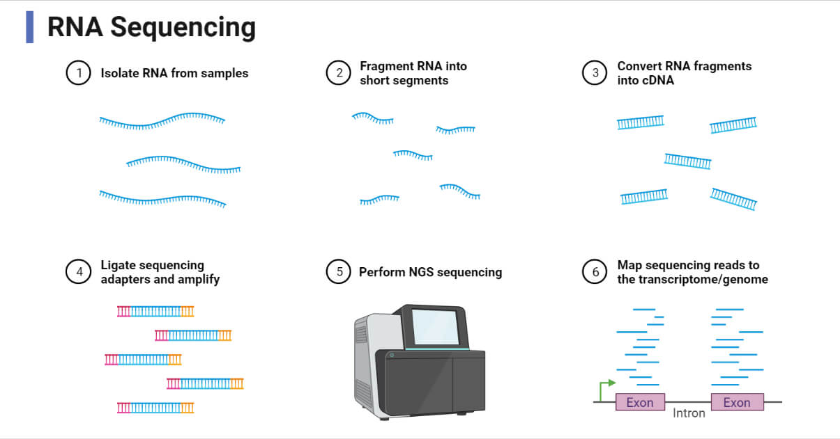
RNA-Seq: Sequence AND Quantification (in Bulk)

Slide 13
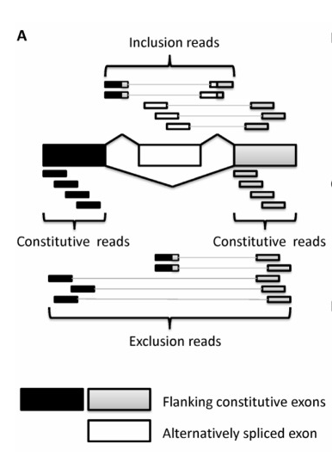
RNA-Seq: Levels of alternative splicing
DNA
DNA

Slide 14
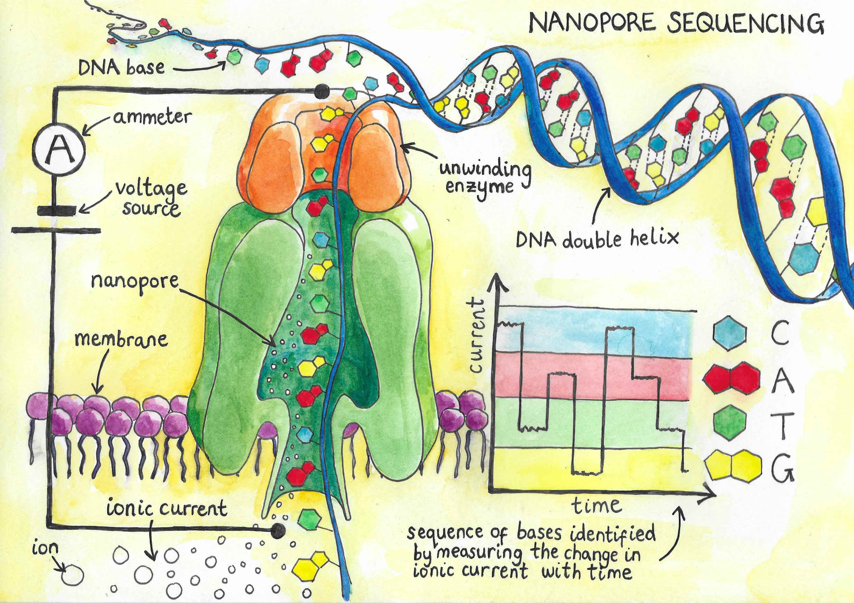
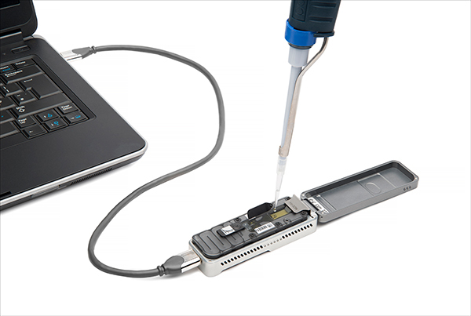
Long Read Seq: Levels of alternative splicing
Long Reads – Low per read accuracy
Great for structural variation (alt splicing)

Slide 15
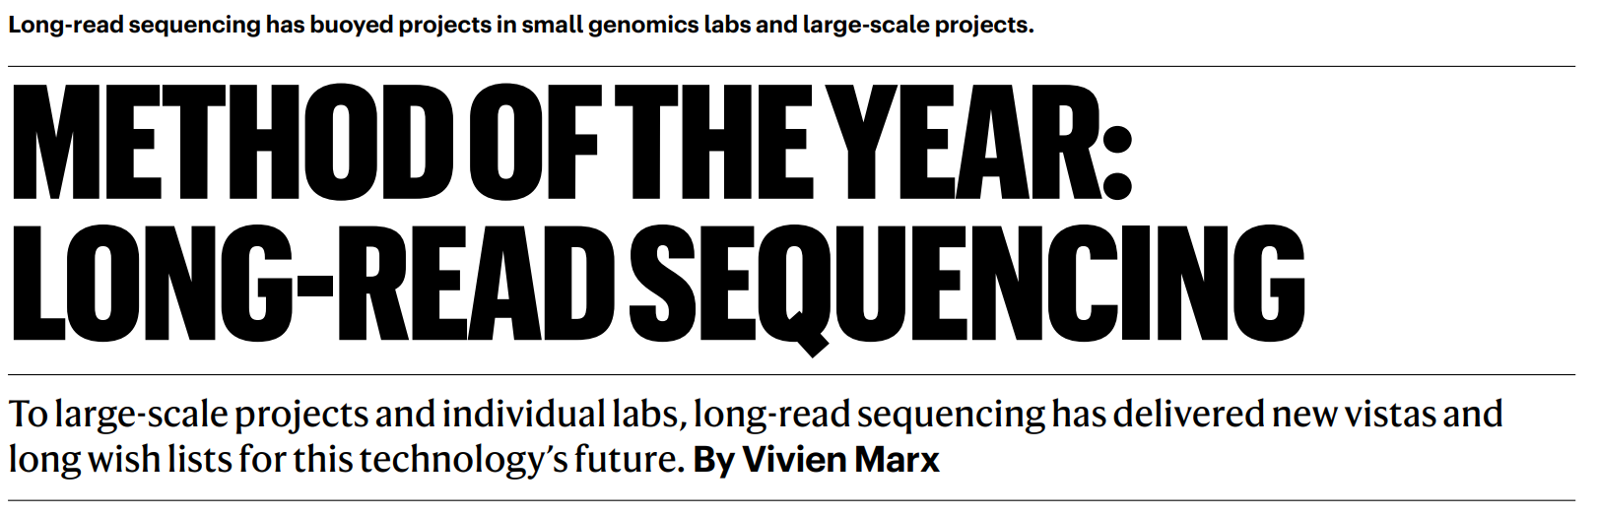
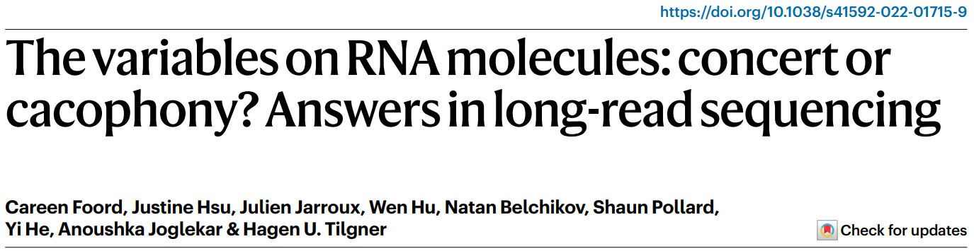
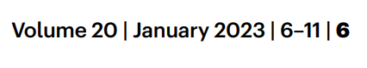
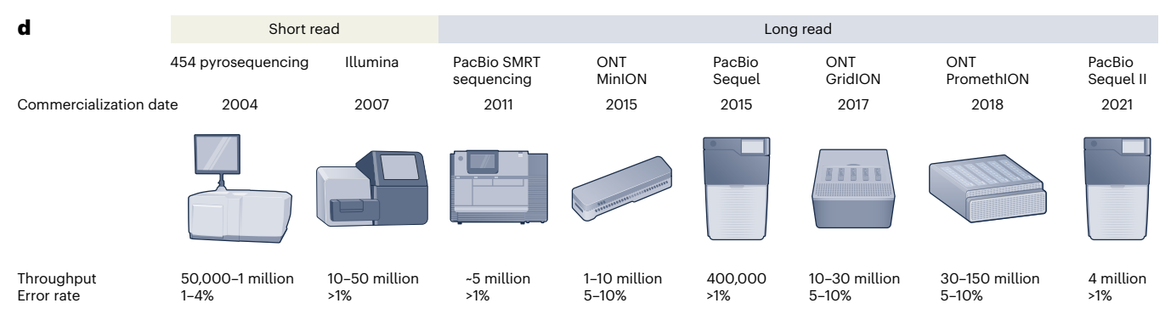

Slide 16
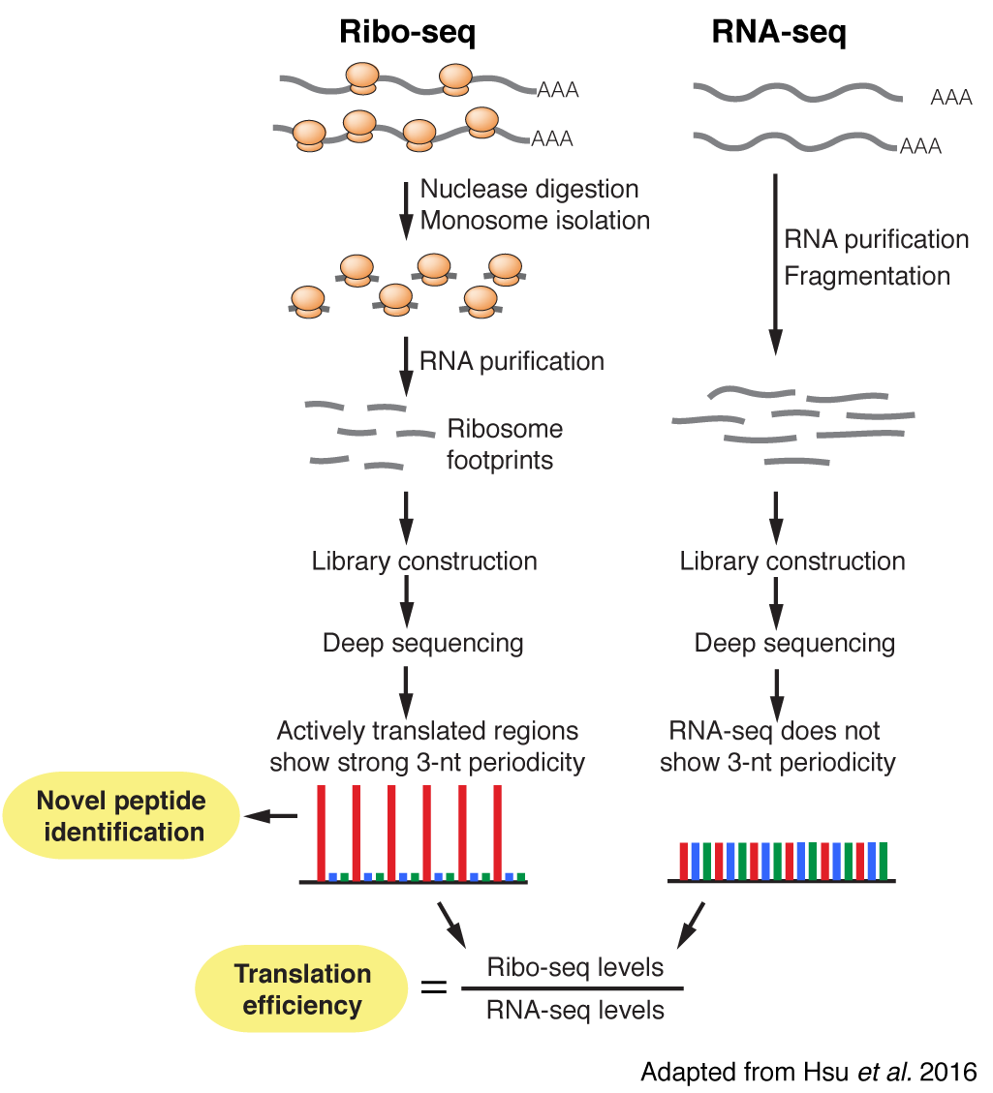
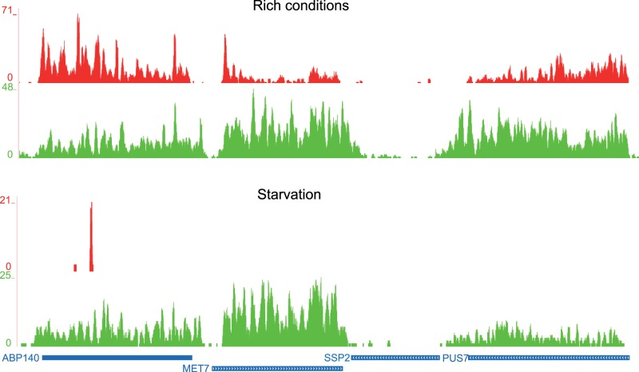
Ribo-Seq
Identification of actively translated RNA
Exact position of Ribosome

Slide 17
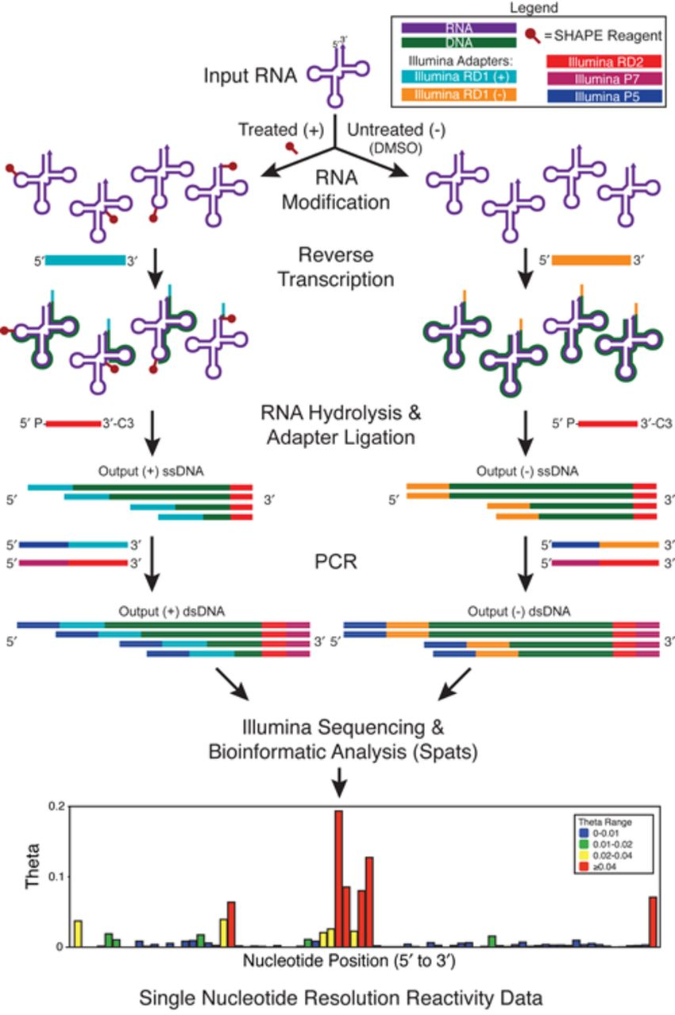
Shape-Seq

Slide 18
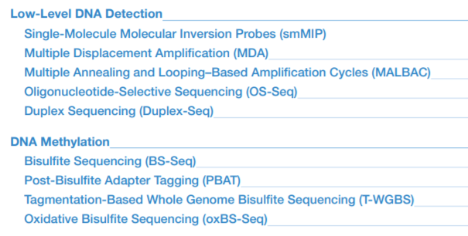
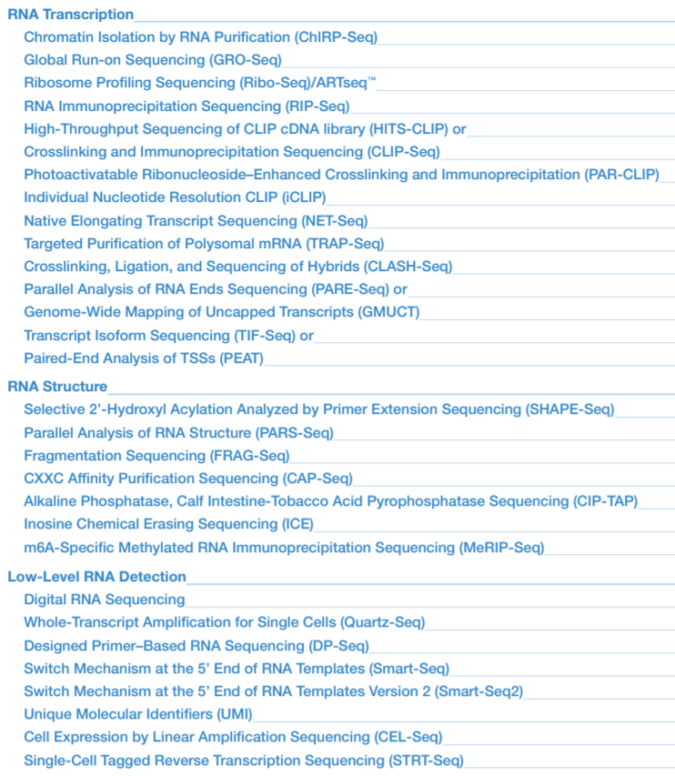
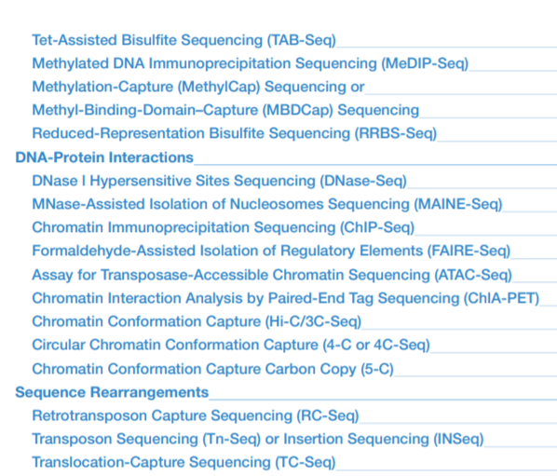

Slide 19

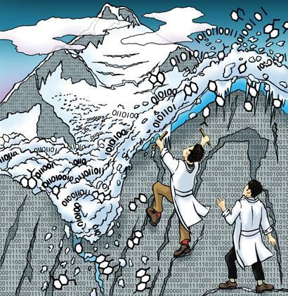
Landscapes of Transcriptomic Data
1 Genome
TranscriPtome
Per
Tissue
Time
condition

Slide 20
Landscapes of Transcriptomic Data
1 Genome
Expression Levels
Sequence Variation
TranscriPtome
MODALITIES
“TranscriPtome”
Per
Tissue
Time
condition
Splicing Variation
Epitranscriptomics

Slide 21
Landscapes of Transcriptomic Data
SPATIAL TRANSCRIPTOMICS
1 Genome
Expression Levels
Sequence Variation
TranscriPtome
MODALITIES
“TranscriPtome”
Per
CELL
LOCATION
Time
Condition
Splicing Variation
SINGLE CELL
TRANSCRIPTOMICS
Epitranscriptomics

Slide 22
Landscapes of Transcriptomic Data
Million Genomes
TranscriPtome
MODALITIES
SPATIAL TRANSCRIPTOMICS
“TranscriPtomes”
Per
CELL
LOCATION
Time
Condition
Expression Levels
Splicing Variation
Sequence Variation
SINGLE CELL
TRANSCRIPTOMICS
Epitranscriptomics

Slide 23

Transcriptomic
Data
Analysis

Slide 24
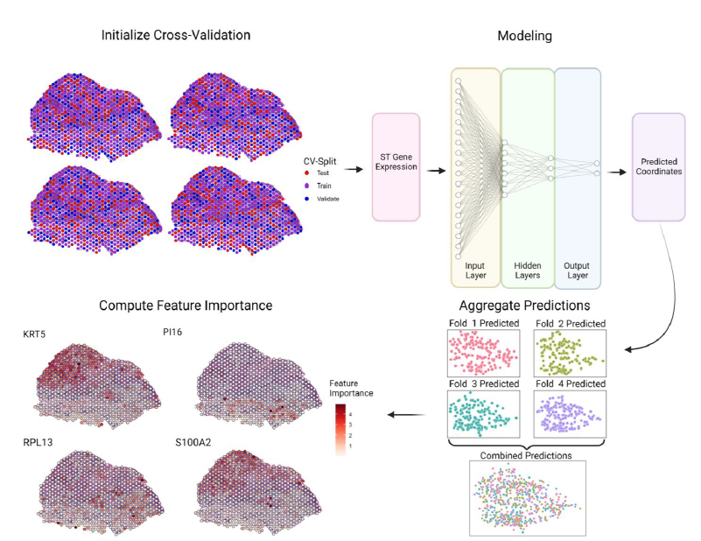
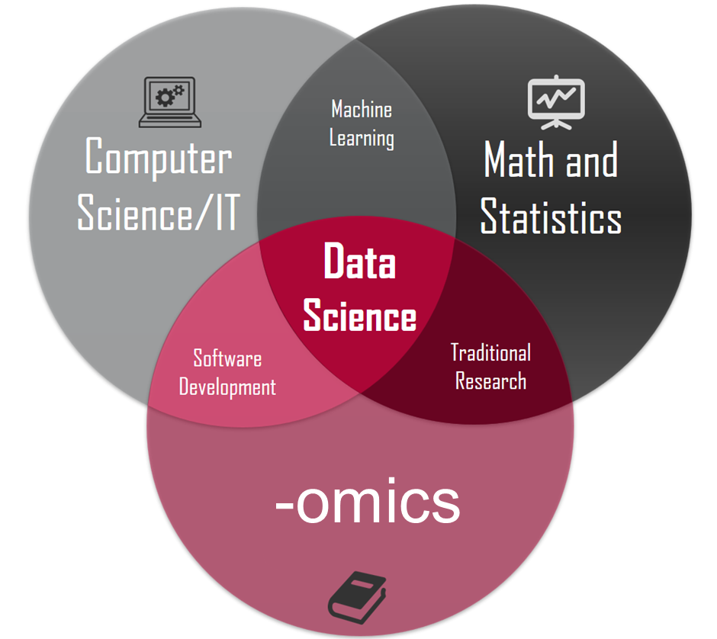



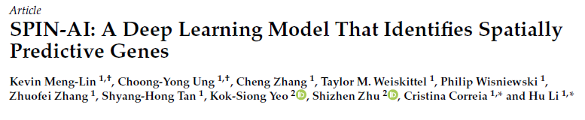
RNA
SPATIAL
MACHINE
LEARNING
EXPLAIN-
ABILITY

Slide 25
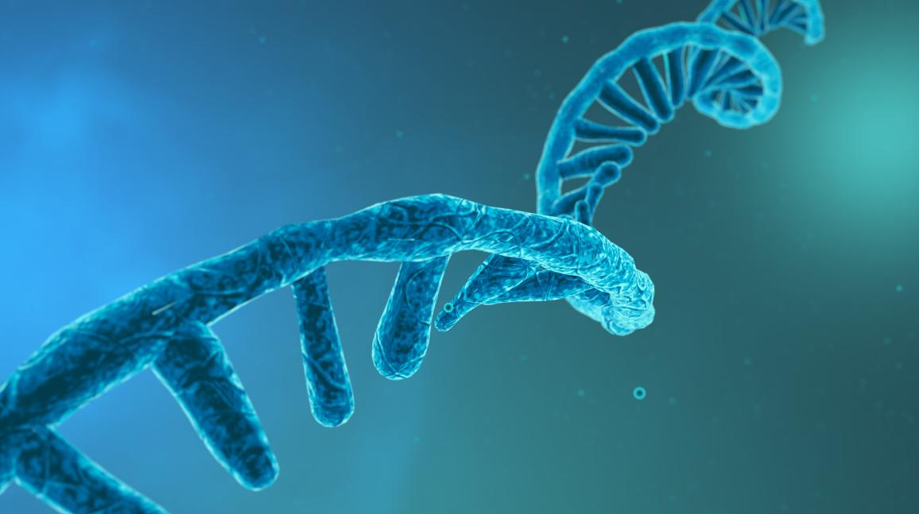
Transcriptomics Data Science
Hot –omics field for the next 2-5 years
Multi-omics Data Science
Hot –omics field for the next 5-10 years

Slide 26

Transcriptomics Data Science
Hot –omics field for the next 2-5 years
Multi-omics Data Science
Hot –omics field for the next 5-10 years

Slide 27







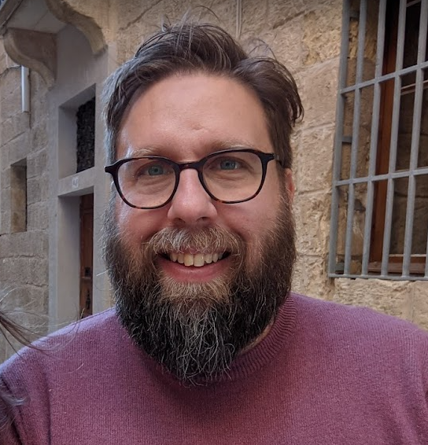


Monday
Tuesday
Tuesday
Wednesday
Wednesday
Thursday
Friday
Intro to Genomic Data
Intro to Transcriptomics
Computer Aided Drug Design
Breakthroughs and Challenges in Multi-omics
Browsing Genes and Genomes with Ensembl
Deep Learning for Genomics
Explainable Artificial Intelligence (XAI)
Molecular Representation and Random Forests
Dissemination and Communication of Research
Gene regulation discovery in the era of 3rd gen sequencing
ML for Drug Discovery
Explainability for Deep Neural Networks
CNNs for genomic annotation
DL for Protein Structure
Round Table:
Biomedical Research and AI
GitHub Repository
Panos Alexiou
panagiotis.alexiou@um.edu.mt
https://github.com/BioGeMT/MALTAomics-Summer-School

